Slide 1
Programming Principle and Techniques
SELECTION & REPETITION
CONTROL STRUCTURES
Notes:
1-13

Slide 2
Learning Outcomes
By the end of this session, you should be able to:
Write C syntax for single selection, dual selection and multiple selection structures;
Determine between the if and switch statement based on the problem given;
Implement C repetition structure using for, while and do-while statements;
Notes:
1-13

Slide 3
Learning Outcomes (cont.)
5. Differentiate between for, while and do-while statements; and
6. Write nested loops depending on the problem given.
Notes:
1-13

Slide 4
Introduction
There are 3 main structures in algorithm:
  Sequence
  Selection
  Repetition
Sequence – statements are executed one-by-one in sequence.
Selection – if, switch
Repetition – for, while, do-while
Notes:
1-13

Slide 5
if Statement
Statement could mean to be more than one statement.
Multiple statements are called compound statements. They must be surrounded by the braces { and }.
Example:
  if(k < j){
  min = k;
  printf(“k less than j\n”);
  }
Notes:
1-13

Slide 6
if/else statement
#include <stdio.h>
void main()
{
int marks;
printf(“Enter the marks: ”);
scanf(“%d”, &marks);
if(marks >= 40)
printf(“PASS!\n”);
else
printf(“FAILED!\n”);
}
Notes:
1-13

Slide 7
Multiple if/else Statement
#include <stdio.h>
void main()
{
int marks;
printf(“Enter the marks: ”);
scanf(“%d”, &marks);
if(marks >= 80 && marks <= 100)
printf(“Gred = A\n”);
else if(marks >= 60 && marks <=79)
printf(“Gred = B\n”);
else if(marks >= 40 && marks <=59)
printf(“Gred = C\n”);
else
printf(“Gred = F\n”);
}
<number> - 13
Notes:
1-13

Slide 8
switch Statement
switch statements are used to select only one choice from many choices.
The choice is dependent on the value for one variable or simple expression.
The value of the expression only be of int and char types, but not float type.
Notes:
1-13

Slide 9
switch Statement
General syntax:
switch(expression){
case expression-1:
statement-1;
break;
case expression-2:
statement-2;
break;
:
case expression-m;
statement-m;
break;
default:
statement-n;
break;
}
Notes:
1-13

Slide 10
Program
#include <stdio.h>
Void main()
{
int choice;
printf(“Input menu choice: ”);
scanf(“%d”, &choice);
switch(choice){
case 1:
printf(“Nasi lemak\n”);
break;
case 2:
printf(“Roti canai\n”);
break;
case 3:
printf(“Lontong\n”);
break;
default:
printf(“Not in the menu\n”);
break;
}
}
Notes:
1-13

Slide 11
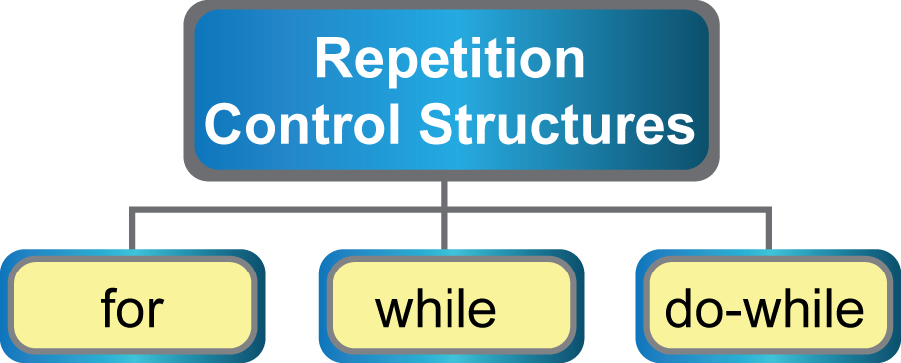
Repetition
Notes:
1-13

Slide 12
for Statement
General syntax:
  for(initialization;test;update)
  statement;
Explanation:
  Two parts: head and body
  for statement consists of:
    Initialization – initial value referred
    Test – condition to loop
    Update – current value after each loop
  Number of loops are known
Notes:
1-13

Slide 13
for Statement
Partial codes:
    for(x=1; x<=8; x++)
    printf(“%d\t”, x);
Output:
    1 2 3 4 5 6 7 8
Notes:
1-13

Slide 14
while Statement
General syntax:
    while(test)
    statement;
Explanation:
  Two parts: head and body
  Head has only test
Notes:
1-13

Slide 15
while Statement
Partial codes:
    x=1;
    while(x<=8){
    printf(“%d\t”, x);
    x++;
    }
Output:
    1 2 3 4 5 6 7 8
Notes:
1-13

Slide 16
do-while Statement
General syntax:
    do{
    statement;
    }while(test);
Explanation:
  The statement will be executed until the test is false.
  The statement will be executed at least once.
Notes:
1-13

Slide 17
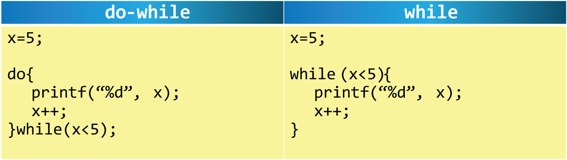
do-while vs while Statement
Notes:
1-13

Slide 18
Nested Loops
Nested loops refer to the looping statement where the body has a looping statement.
For example, for loop has another for loop in the looping.
Example:
  for(i=0; i<2; i++){
  for(j=0; j<5; j++){
  printf(“%d, %d\t”, i, j);
  }
  }
Notes:
1-13

